Slide 1
Collaborative Editing of DDI Metadata: The Latest from the CED²AR Project
Benjamin Perry, Venkata Kambhampaty, Kyle Brumsted, Lars Vilhuber, William C. Block

Slide 2
Outline
Introduction
Problem
Solution
Implementation
Future Work

Slide 3
What is CED²AR?
Funded by NSF grant #1131848
Lightweight, DDI driven web application
Designed specifically for custom DDI schema
Enables search and browsing across codebooks
Provides an open API for developers
Online at www2.ncrn.cornell.edu/ced2ar-web
Notes:
-Grant info
--Five year NSF grant
-Driven entirely by DDI XML with a non relational database called BaseX
--What we import and export is what CED2AR runs off of
-Designed for our custom DDI schema that facilities the release of confidential datasets and their metadata
-Allows users to search and browse across DDI-C files with a focus on variables
-Provides a RESTful API for developers

Slide 4
The Challenge
Infrastructure disconnected from curation process
Researchers not familiar with XML and DDI
Metadata was not being preserved
Notes:
-CED2AR design for those not familiar with metadata standards, not metadata experts
-No support for simple edits to DDI
--Need to download ddi and reupload to change minor parts
-Researchers not comfortable editing XML, frequently confused by schema
--Already difficult to encourage researchers to produce metadata
-Too much manual intervention and required steps

Slide 5
The Solution
Build from existing application
Keep lightweight infrastructure
Automate as much as possible
Prevent steep learning curve
Notes:
-Create a solution which works inside existing web application
--Kept things accessible by maintaining zero install or fast setup
---under 10 minutes
--Kept application cross platform - optimized for desktop, but scales down to tablet and phone
-Automate as much as possible
-Create flexible system scale to our users technical abilities

Slide 6
Current Architecture
Server Instance
Desktop Instance
Tomcat 7 Server
JAR file
Web
Application
Web
Application
Database
Database
Notes:
-Currently, CED2AR runs two ways: on a server or as a desktop application
-Very similar look and feel, either setup is controlled through an internet browser
-Same backend – code is almost identical
-Very few requirements - java 7, tomcat 7. common for most server environments
-The motivation for a local version was two fold:
--Give users a sandbox environment to test ced2ar
--Providing offline functionality for restricted access environments --Offloads the responsibility of security to the user’s computing environment

Slide 7
Process
User logs into CED²AR
User uploads sparse DDI
CED²AR validates and cleans DDI
Users edit codebooks
Git passively versions edits
Changes are pushed to remote location
Notes:
-User authenticates
-User uploads partially complete DDI
--They start with a dataset in SAS, STATA, or R, convert it to DDI
--has values and variables, but little information on
-CED2AR validates the DDI, cleans up xml
-Users access web forms to collaboratively edit codebooks
-Everytime an edit is made, Git versions the changes
-Changes are pushed to a remote location on a scheduled basis, or triggered at a threshold of changes

Slide 8
Structure
3rd Party Authentication
Web Application + Editing Forms
or
Internal Authentication
Database
Local
Repo
Remote Repo
Notes:
-Keeping the existing web application, add editing forms
-Allow for external authentication
-Version codebooks into source code repository, automatically schedule replication

Slide 9

1. Authentication
Support OpenID and OAuth2
Currently using Google with OAuth2
CED²AR handles identity management
Notes:
-CED2AR has the framework to OpenID and OAuth
-Currently, we are using Google with OAuth as a provider
-Identity management is defined within CED2AR. This includes permissions, roles, local user information, etc.

Slide 10
2. Uploading and Ingest
Validates against DDI 2.5 schema
Inserts dates, citations, software references, etc.
Indexes and assigns codebook internal handle
Notes:
-Validation is done against DDI 2.5 schema or our modified DDI 2.5 schema
-CED2AR updates XML with dates, citation, and software used
-CED2AR then indexes the codebook and assigns it an internal handle, giving the codebook a unique URI for the CED2AR instance.
-Can later be linked to a digital object identifier.

Slide 11
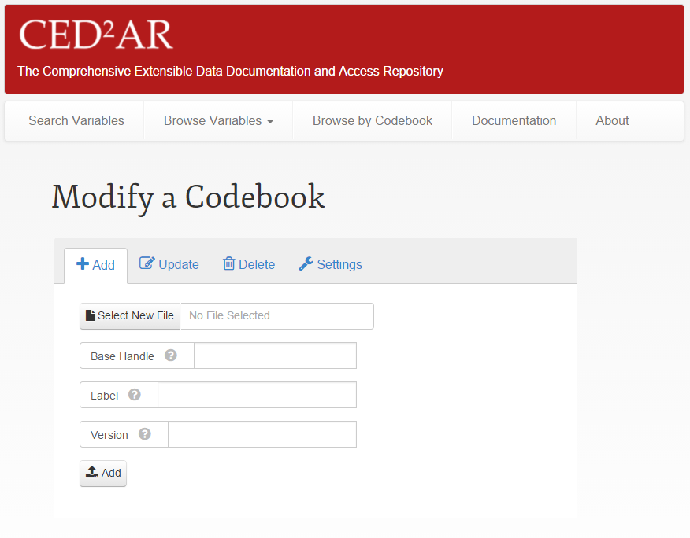
2. Uploading and Ingest
Notes:
-Entire uploading process can done through a user interface, or via the API allowing developers to batch entire directories into the upload que.

Slide 12
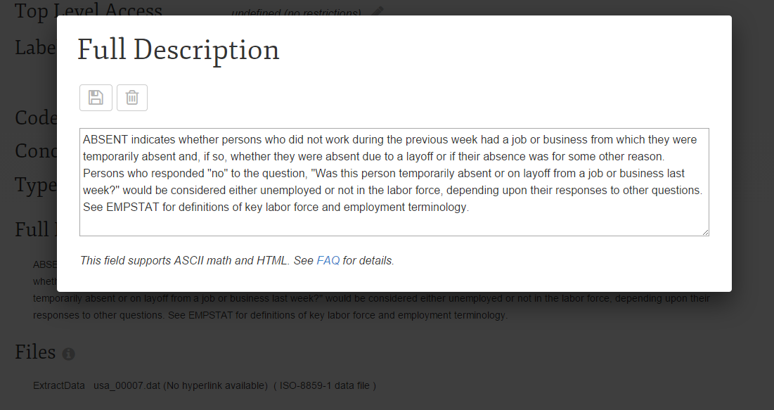
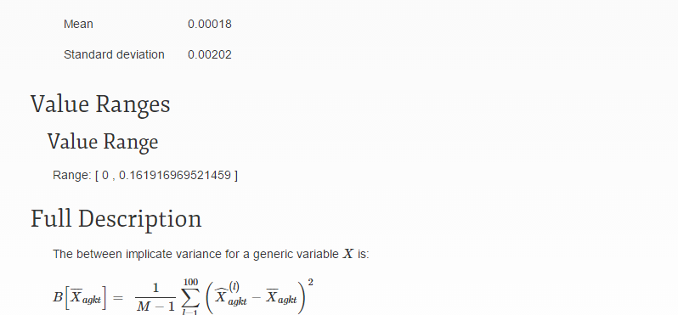
3. Editing Process
User searches or browses
Web forms provide control over content
CED²AR supports basic HTML and ASCII math
Notes:
-User can search or browse for a variable
-CED2AR supports inserting basic HTML and ASCII Math
--ASCII math is similar to LATEX, and allows for displaying mathematical equations without modifying the ddi schema
--Readable in plain text, but enhanced through ced2ar’s rendering

Slide 13
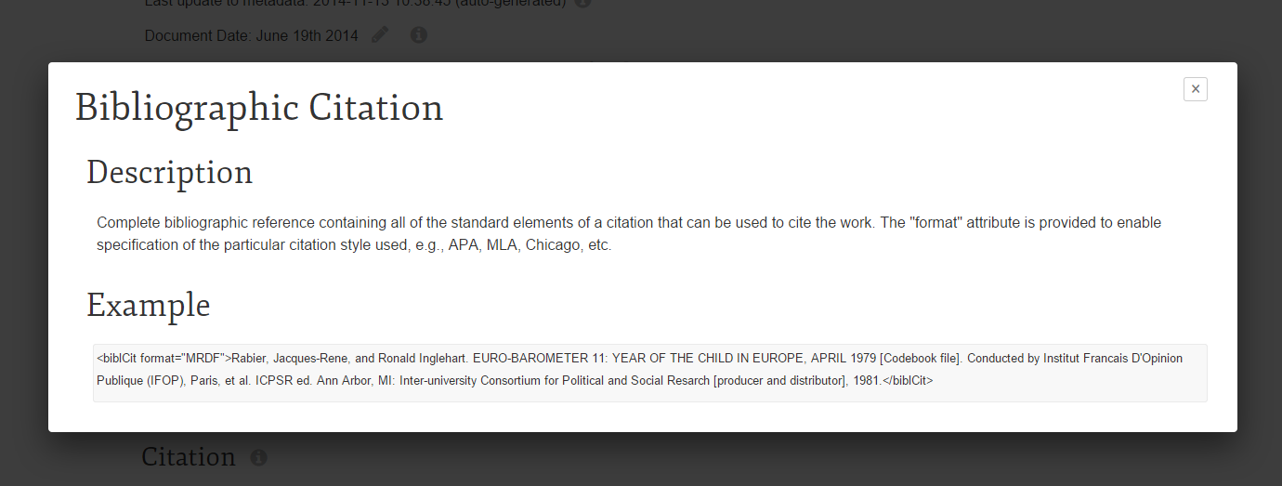
4. Editing Process
Built in documentation
Notes:
-Configuration of CED2AR driven by schema which defines some the inline help.
-Explanation of DDI fields is directly pulled from XSD HTML

Slide 14
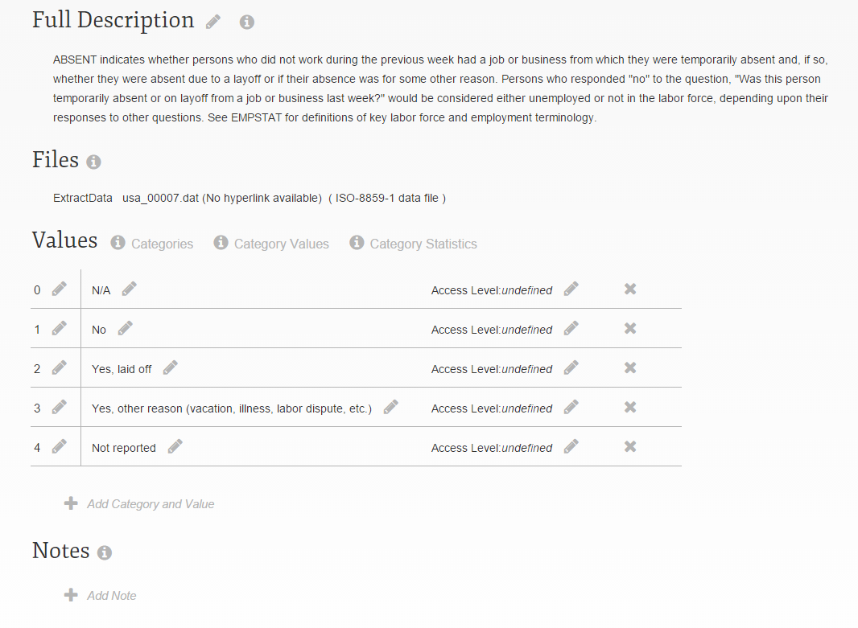
4. Editing Process
Editing a variable
Notes:
-Can edit one variable at a time
-Can specify access levels at sub variable level

Slide 15
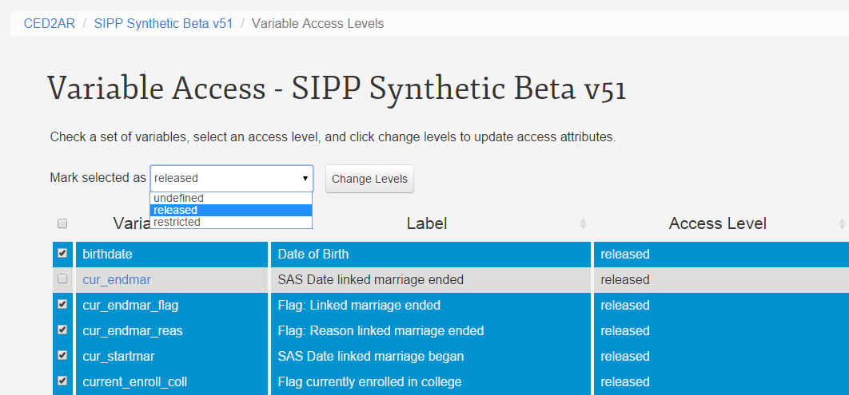
4. Editing Process
Control over multiple access levels
Notes:
-Or multiple variables at once
-By default, access levels are not defined when codebooks are added to CED2AR so users are forced to review

Slide 16
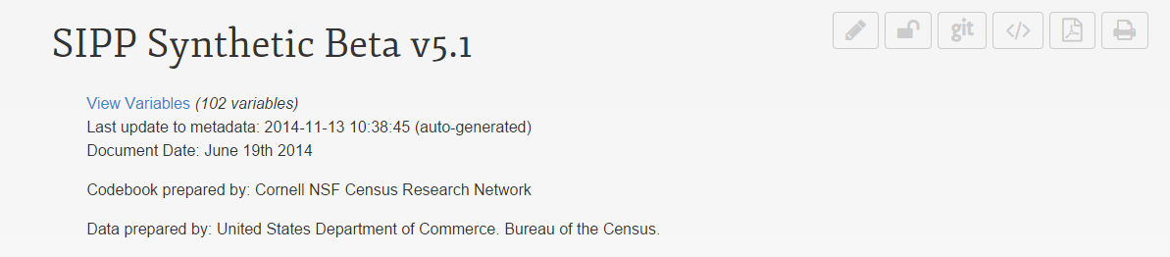
5. Versioning
Uses Git, a distributed version control system
Scheduled tasks check for changes
Once changes exceed threshold, they are pushed
Pending changes are pushed after a time limit
Notes:
-Git is a distributed version control system
--Distributed meaning there is no central repository
-Git is scheduled to run in the background, regardless of the users’ actions
-Changes are documented within DDI

Slide 17
6. Remote Location
Our implementation uses Bitbucket
Commit messages describe changes
Users linked by email address
Commit hashes are stored on CED²AR
Notes:
-Changed synchronized with cloud based repository called BitBucket
-Changes are available to view or download online
-Each commit is a compilation of changes
--Within the commit message, user’s edits are referenceable by unique elements in DDI and their email address

Slide 18
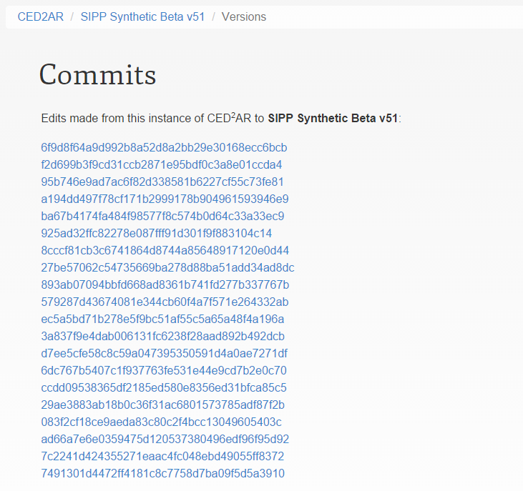
6. Versioning
Viewing version history
Notes:
-We keep track of commits made from a specific instance locally in CED2AR-
defined variable or codebook level
-commits are id’d by a unique hash

Slide 19
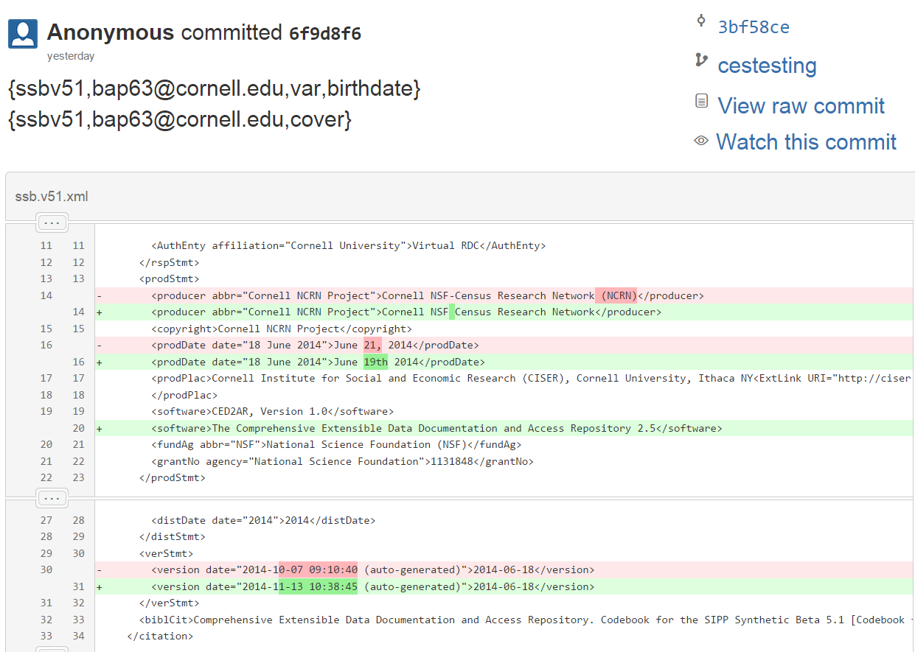
6. Remote Location
Notes:
Remote repository could be cloud based, local, or even offline
User has the possibility to disable remote pushes

Slide 20
Use Case
CED²AR Server Instance
Remote Repo
CED²AR Desktop Instance
CED²AR Desktop Instance
Notes:
-Users can from multiple CED2AR instances can all interact with the same repo
-Users can use the version control software to take work offline
-Multiple users can be working on the same codebook

Slide 21
Future Work
Focusing on crowdsourcing
Enhancements to our DDI editor
Open a demo up to the public
Notes:
-Next step is open this to the public
--With that comes new challenges such as moderation, registration, and…
--Still waiting on licensing to release source code
-Enhancements to DDI editor, a richer UI to create a codebook from scratch.

Slide 22
Thank you!
Questions?
ced2ar-devs-l@cornell.edu

